Slide 1
Preparation for NABL Accreditation in Medical laboratories – First Phase: Application Explained
Dr. Bipin Patel
13/02/2019

Slide 2
Objectives of First Phase
Awareness of NABL accreditation processes
Defining the Scope for accreditation
Understanding of Preparation of Quality Manual

Slide 3
Agenda of 13/02/2019 Meet
Understanding of activities of NABL
Understanding of Accreditation Processes
Understanding of Application Processes
Requirements for Application
About Standards
Home Work

Slide 4
What is NABL?
What is full name of NABL?
What are the activities carried out by NABL?
What is the address of web portal of NABL?
What is communication address of NABL?
How are in top management of NABL?
What are the fees for accreditation?

Slide 5
What is full name of NABL?
NABL full name is
National Accreditation Board for Testing & Calibration Laboratories

Slide 6
What are the activities carried out by NABL?
NABL has been established with the objective to provide
a scheme for third-party assessment of the quality and technical competence of testing and calibration laboratories.
Clients of NABL Scheme are
Government,
Industry Associations and
Industry in general

Slide 7
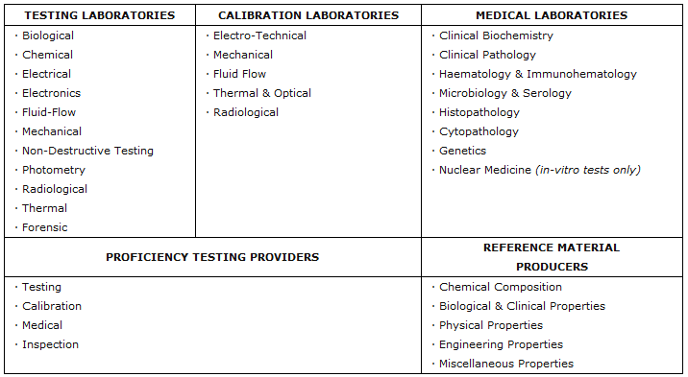
What are the activities carried out by NABL?
Various Scheme for Accreditation are

Slide 8
What is the address of web portal of NABL?
https://www.nabl-india.org

Slide 9
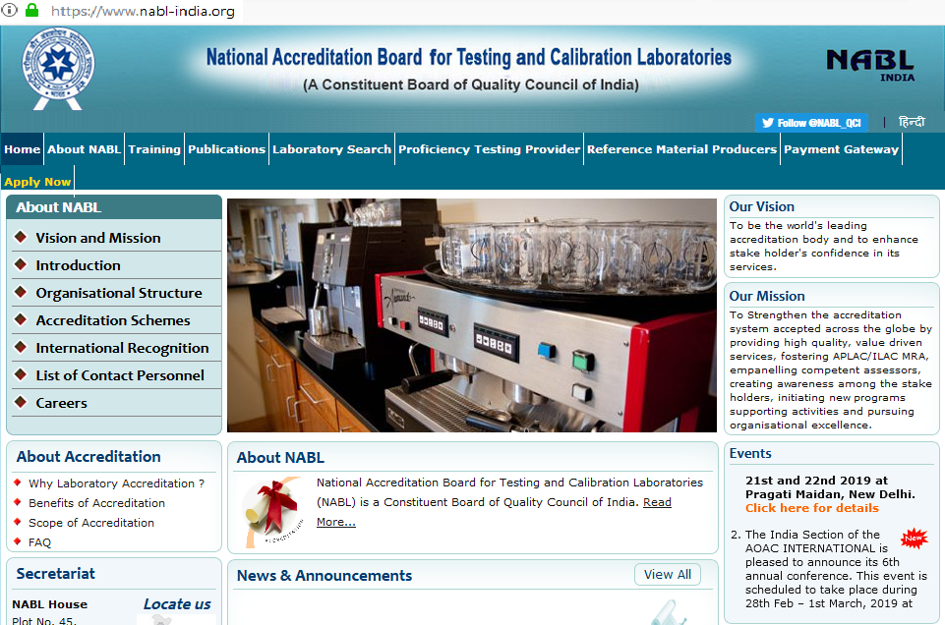

Slide 10
What is communication address of NABL?
NABL Secretariat (All Correspondence should be addressed to NABL Secretariat)
National Accreditation Board for Testing and Calibration LaboratoriesNABL House Plot No. 45, Sector 44, Gurugram – 122002, Haryana Tel. no.: 91-124-4679700 (30 lines) Fax: 91-124-4679799 Website: www.nabl-india.org (Landmark – Near HUDA City Centre Metro Station, Behind Fortis Hospital)

Slide 11
How are in top management of NABL?
For details of contact persons of NABL, visit https://www.nabl-india.org/about-nabl/list-of-contact-personnel/.
Some of top management names are:
1. Mr. Anil Relia, C.E.O., Overall responsibility of NABL Accreditation Programme
2. Mr. P.X. Xavier, Assistant Director, Personal Secretary to CEO
3. Dr. Vandana Jain, Director, Head – Accreditation of Medical Testing Laboratories
4. Mr. N. Venkateswaran, Director , Head – Accreditation of Testing Laboratories, Proficiency Testing Provider & Reference Material Producer
5. Mr. Avijit Das, Director ,Head-Accreditation of Calibration Laboratories

Slide 12
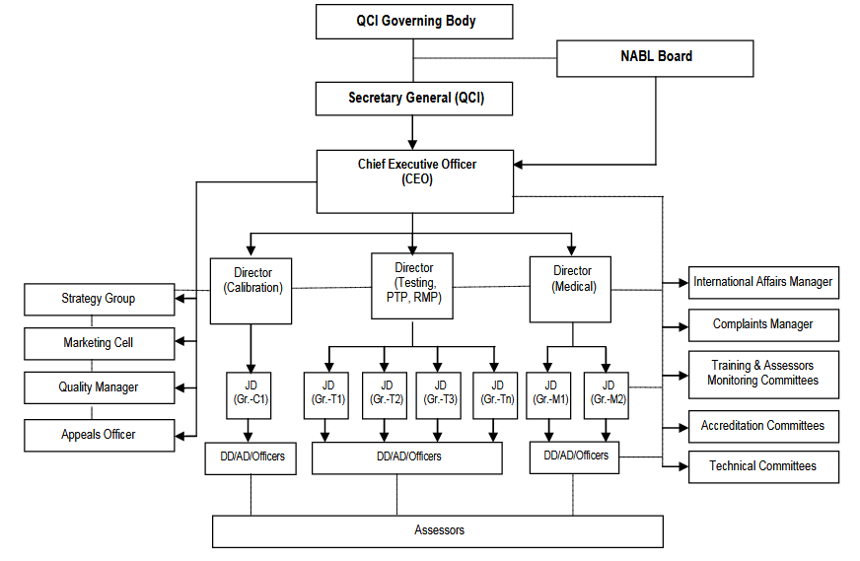
Organogram

Slide 13
What are the fees for accreditation?
Refer Doc. No. 100 on NABL website, publication section for more details.
For the year 2018-2019, fees for Medical Laboratories (covering all fields) & Associated Sample Collection Centre/Facility (SCF) for Small Laboratories (below 100 patients/day/location+) are:

Slide 14
What are the fees for accreditation?
Application Fee: Rs. 18,700 + Rs. 200 per SCF
Enhancement of Scope (apart from the scheduled re-assessment): Rs. 5,500 & Rs. 200 per SCF
Change in Authorized signatory: Rs. 5,500 / request
Change of Certificate: Rs. 5,500
Annual Accreditation Fee (per year from the date of accreditation): Rs. 20,000 + Rs. 1,000 per SCF
Overhead Charges: Rs. 11,000

Slide 15
What are the fees for accreditation?
Assessment Charges (payable after the completion of assessment visit to the CAB):
Travel, Boarding, Lodging
Honorarium for NABL Assessors
Document review by Lead Assessor Rs. 2,000
Pre-Assessment, Assessment, Surveillance, Verification, Special Visit
by Lead Assessor Rs. 4,500 per day
by Technical Assessor/ Expert Rs. 4,000 per day

Slide 16
What are the fees for accreditation?
In addition to the above mentioned fee, GST @ 18.0 % is to be paid along with said charges / fees.
Total Cost of One Year Cycle in first year is approx. 75756 + actual expense of assessor’s travel, lodging & boarding if one lead & two technical assessors allotted for assessment.

Slide 17
Documents Required for accreditation
ISO 15189:2012 edition standard.
NABL-Doc. 112: Specific Criteria for Accreditation of Medical Laboratories, issue no. 03 till 01/06/2019
NABL-Doc. 112: Specific Criteria for Accreditation of Medical Laboratories, issue no. 04 after 01/06/2019
NABL-Doc. 153: Application Form for Medical Testing Laboratories
NABL-Doc. 133: NABL Policy for Use of NABL Symbol/ Claim of Accreditation by Accredited Conformity Assessment Bodies & NABL Accredited CAB Combined ILAC MRA Mark
NABL-Doc. 142: Policy on Traceability of Measurements
NABL-Doc. 163: Policy for Participation in Proficiency Testing Activities

Slide 18
Documents Required for accreditation
NABL-Doc. 131: Terms and Conditions for obtaining and maintaining NABL accreditation
NABL-Doc. 100: General Information Brochure
NABL-Doc. 201: Procedure for dealing with changes in Accredited Conformity Assessment Body's Operations
NABL-Doc. 216: Procedure for dealing with adverse decision

Slide 19
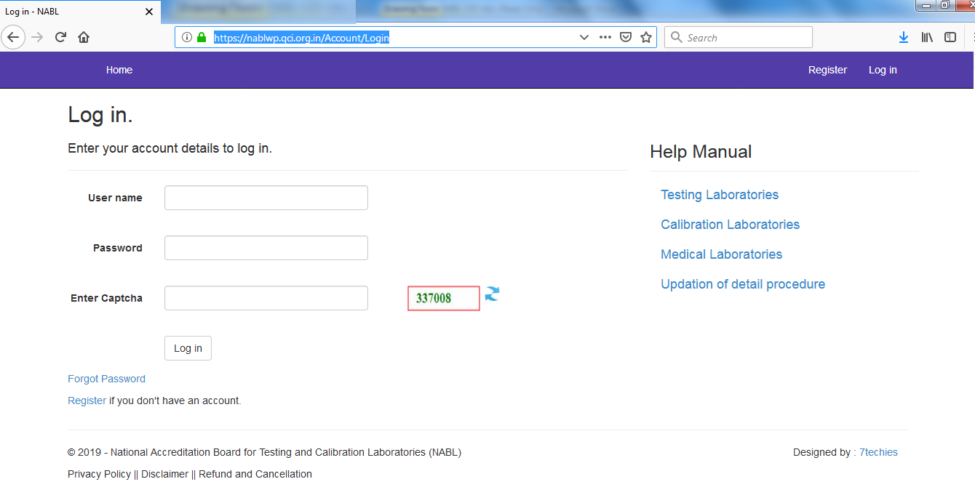
Application
Online application required.
https://nablwp.qci.org.in/Account/Login

Slide 20
Application
During application following things required
Laboratory Quality Manual
Prescribed application fees
Duly signed NABL-131

Slide 21
Application
During application following things required
Photocopy of appropriate document(s) in support of the legal status claimed eg.
Registration Certificate under Indian companies Act,
Limited Liability Act,
Partnership Act,
Registration of Business as Sole Proprietor,
Indian trust Act,
Societies Registration Act,
Any Government notification in support of establishment of institution/ laboratory or any approval from local or regulatory bodies etc.

Slide 22
Application
Information regarding Discipline Required
Clinical Biochemistry
Clinical Pathology
Haematology and Immunohaematology
Microbiology and Serelogy
Histopathology
Cytopathology
Genetics
Nuclear Medicine (in-vitro tests only)

Slide 23
Application
The scope of accreditation which includes
materials or items tested
specific tests or types of tests performed
specification, standard (method) or technique used
range of testing/ limit of detection for each test (as applicable)
% CV (or) uncertainty of measurement (MU) for each test (wherever applicable) at a confidence probability of 95%.
Sl no | Type of Samples examined/tested | Specific tests/ examination performed | Standard (method), Principle /Methodology or technique used | Range of testing/ Limit of detection | %CV / MU (± )

Slide 24
Application
Organization
3.1 Senior Management (Name, Designation, Telephone, Fax, E-mail)
3.1.1 Chief Executive of the laboratory
3.1.2 Laboratory Director
3.1.3 Person responsible for the management system
3.1.4 Person responsible for technical operations
3.1.5 Contact person for NABL

Slide 25
Application
Authorized Signatories
Sl no | Laboratory/ Department/ Section | Name & Designation of Signatory | Qualification with Specialization | Experience in years related to present work | Relevant Training | Part time / Full time (timings if part time) | Authorised for which specific area of testing | Specimen Signature

Slide 26
Application
Organization Chart

Slide 27
Application
Employees
* Please clearly indicate the field of specialization
⁺ Quality Manager shall have 4 days training course on laboratory management system from a reputed institute
Note: Laboratory operating in shifts shall clearly identify the staff working in shifts
Sl no | Name | Designation⁺ | Academic and Professional Qualifications* | Experience related to present work (in years)

Slide 28
Application
Equipment
Sl no | Name of equipment | Model/ type/ year of make | Receipt date & date placed in service | Range and accuracy | Date of last calibration | Calibration due on * | Calibrated by**

Slide 29
Application
Reference Materials
Sl. no. | Name of reference material/ strain/ culture | Source | Date of expiry/ validity | Traceability

Slide 30
Application
Internal Audit and Management Review
Date /schedule of last Internal Audit
Date of last Management Review

Slide 31
Application
During application following things required
Participation satisfactorily in the Proficiency Testing program / EQAS conducted by APLAC or NABL any other national or international accredited/ recognized PT provider. For participation in PT, refer NABL document NABL 163
Sl. no. | Product/ Material | Details of Test(s)/ examination | Date of Testing/ examination | Organizing body | Performance in terms of z score or any other criteria | Corrective action taken (if required)

Slide 32
Application
Declaration by the laboratory

Slide 33
Application
Annexure - A
Sample Collection Centre/ Facility (SCF) (To be submitted by lab declaring SCFs)
Give Details of Sample Collection Centre/ Facility (Add rows for more SCFs)

Slide 34
Application
Application Form - Check List

Slide 35
Questions
???

